Slide 1
GregoryMills.com
Sculptor | Photographer | Technologist
© 2016 by Gregory Mills

Slide 2
Getting a Museum Show

Slide 3
Start with galleries, not museums
Create a website (SquareSpace or Wix or Weebly)
Photos of your work (10 to 25)
Artist statement
Curriculum vitae
Do not put family photos on website
Send website link to curator or gallery director
Do what you say you will do and do it on time

Slide 4
Photographing your art

Slide 5
Set your camera to highest quality
Raw or JPEG Fine/Large
Never touch your original photos
Make copies resized for your output

Slide 6
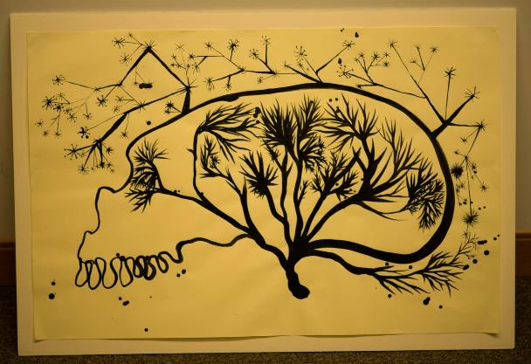
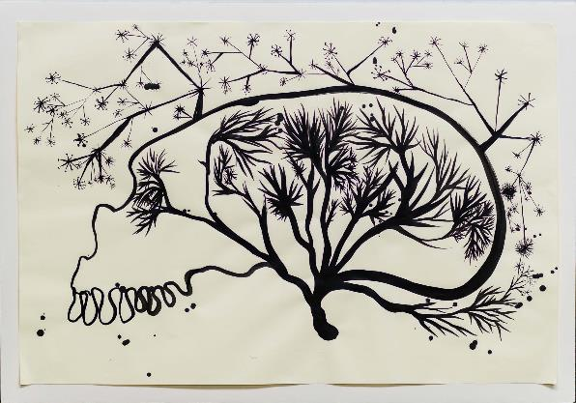
Incorrect Colors or Color Cast

Slide 7
Incorrect Colors or Color Cast
Auto
Daylight
Cloudy
Use correct white balance setting in the camera for the light you are using
Shade
Tungsten
Florescent
Flash
Custom

Slide 8
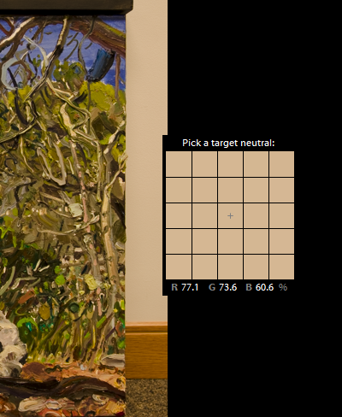
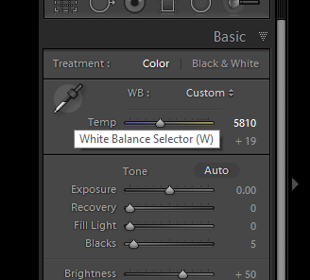
Incorrect Colors or Color Cast
Use White Balance Selector Dropper to select white or neutral gray object

Slide 9
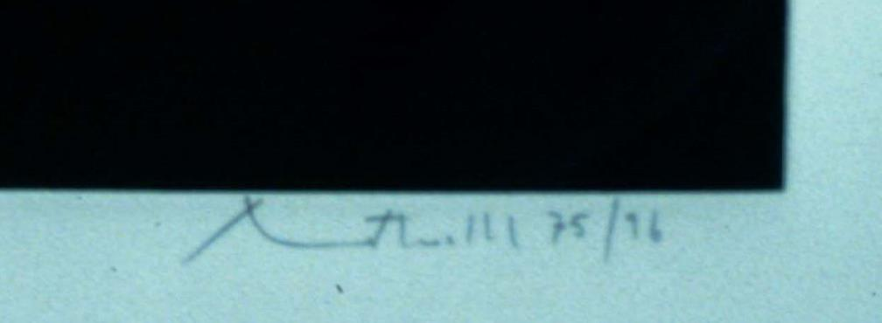
Blurry Photos

Slide 10
Blurry Photos
Rule #1
Stop hand holding the camera!

Slide 11
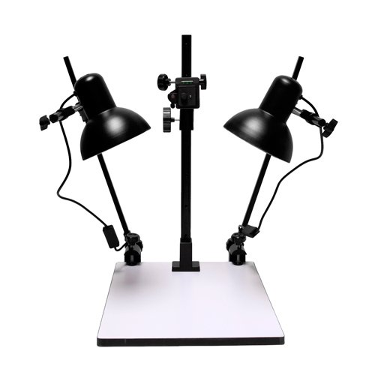
Blurry Photos
Copy stand for small artworks

Slide 12
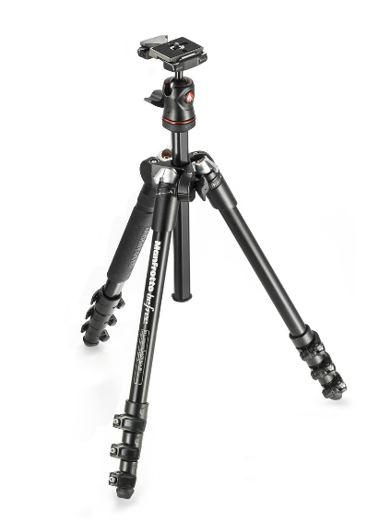
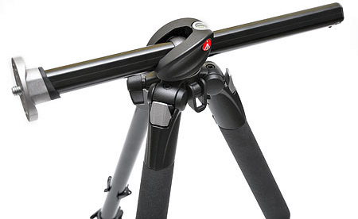
Blurry Photos
Tripod for larger artworks

Slide 13
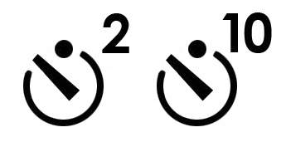
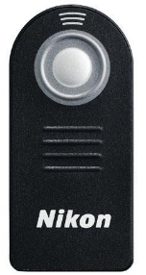
Blurry Photos
Use the camera’s self timer
(or a remote shutter release)
with tripod for maximum sharpness

Slide 14
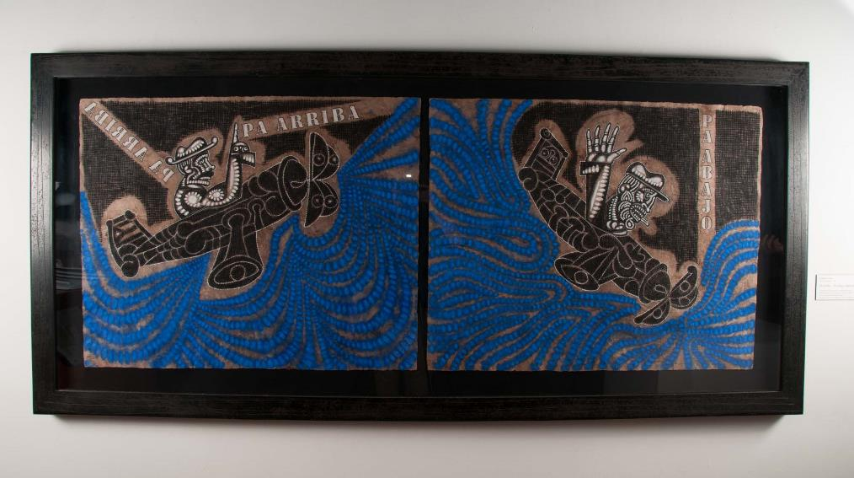
Uneven Lighting

Slide 15
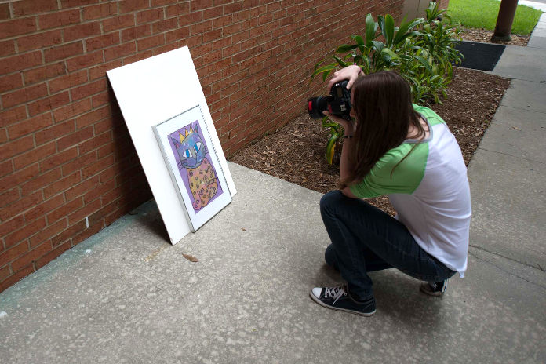
Uneven Lighting
Take photos outside
Cloudy days are best
Glass will cause glare

Slide 16
Glare & Reflections

Slide 17
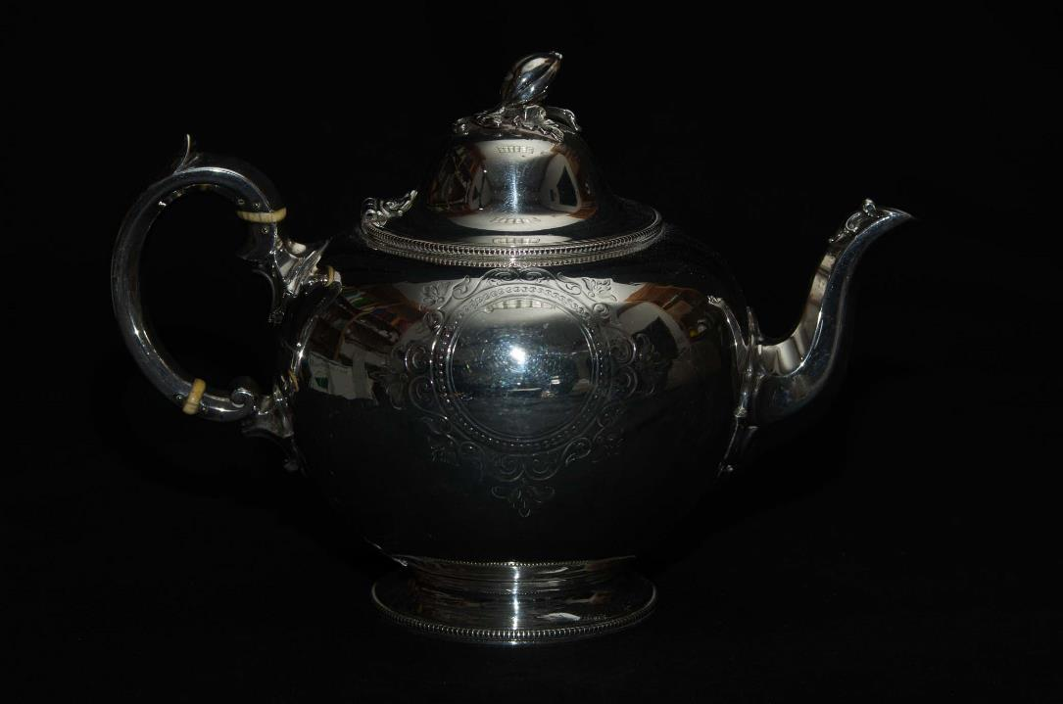
Step 1 - Turn off the flash on your camera!

Slide 18
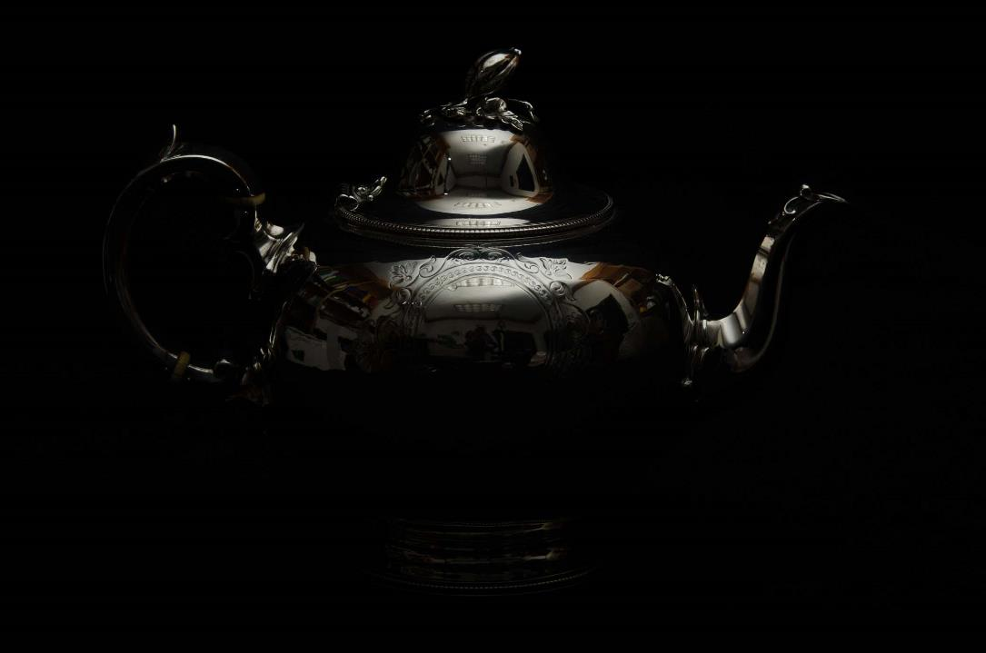
Step 1 - Turn off the flash on your camera!

Slide 19
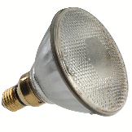
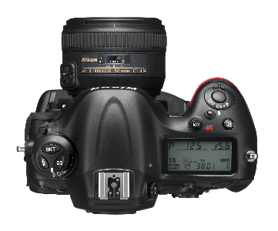
Glare & Reflections

Slide 20
Glare & Reflections
Remove glass from the artwork if possible…

Slide 21
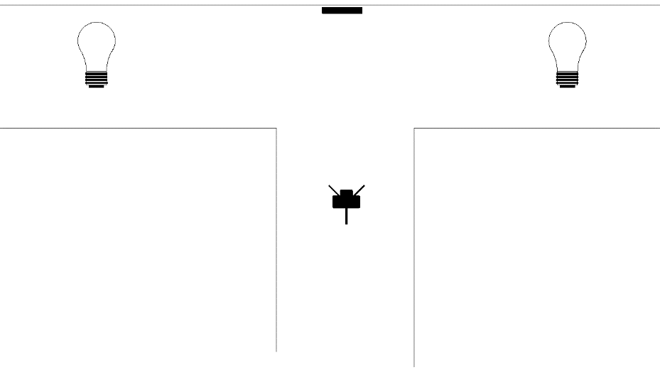
Glare & Reflections
…or use a T-Intersection
in a hallway if you can’t remove glass
or if art has a
high gloss finish
Turn off lights where the camera is
Side-light the artwork from each side
Don’t wear white

Slide 22
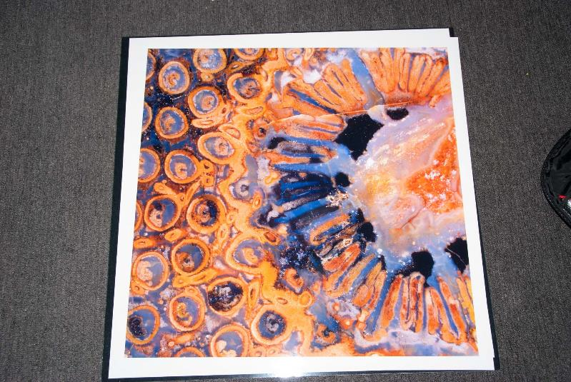
Perspective Distortion

Slide 23
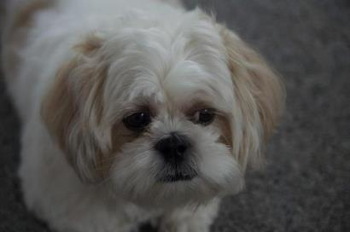
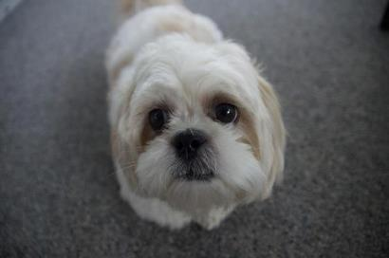
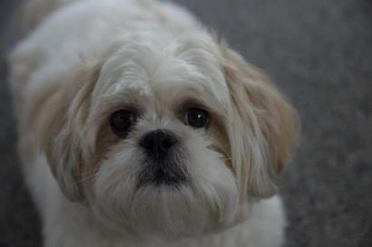
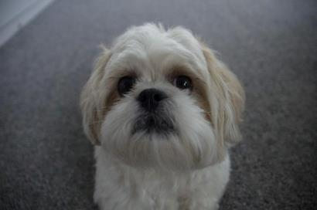
Perspective Distortion
Get far away and zoom in with the camera lens
55mm
18mm
55mm
18mm

Slide 24
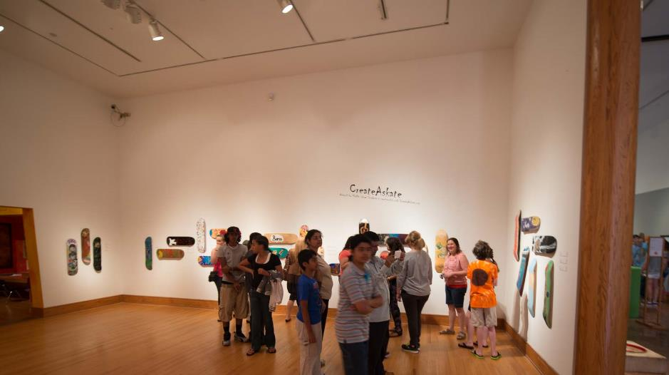
Perspective Distortion
Align center of camera with center of artwork

Slide 25
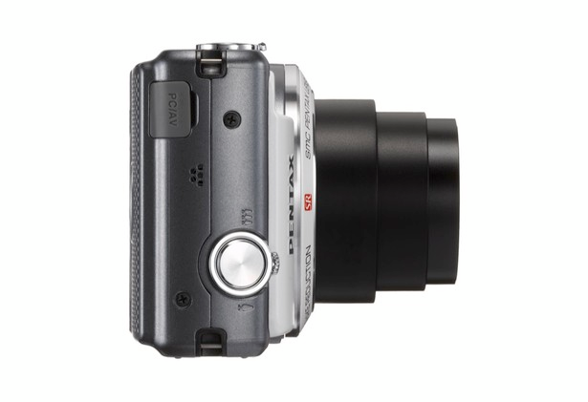
Perspective Distortion
Right
Keep camera senor parallel to the artwork

Slide 26
Perspective Distortion
Wrong!
Keep camera senor parallel to the artwork

Slide 27
Perspective Distortion
Right
Keep camera senor parallel to the artwork

Slide 28
Perspective Distortion
Wrong!
Keep camera senor parallel to the artwork

Slide 29
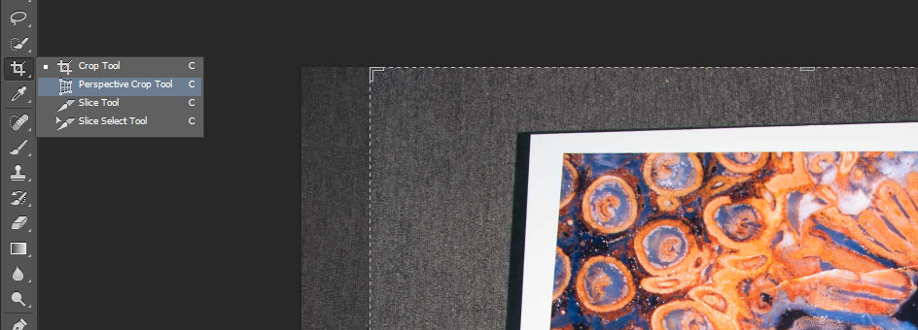
Perspective Distortion
Shoot wide and straighten edges in Photoshop CS6 or CC with
Perspective Crop Tool

Slide 30
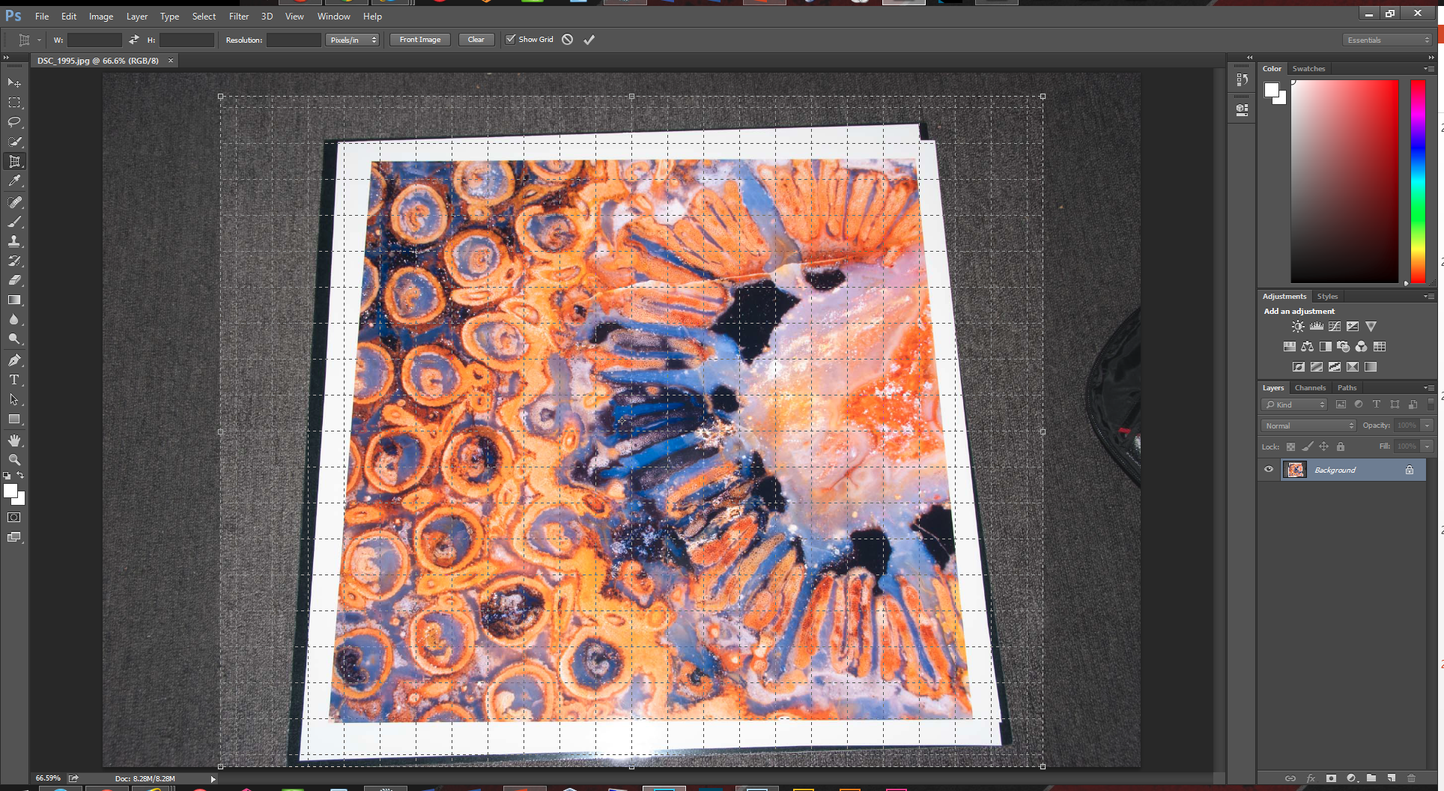
Perspective Distortion

Slide 31
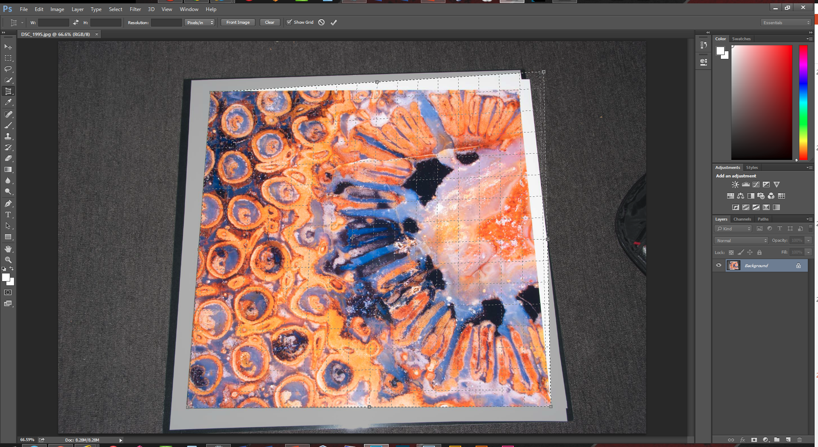

Slide 32
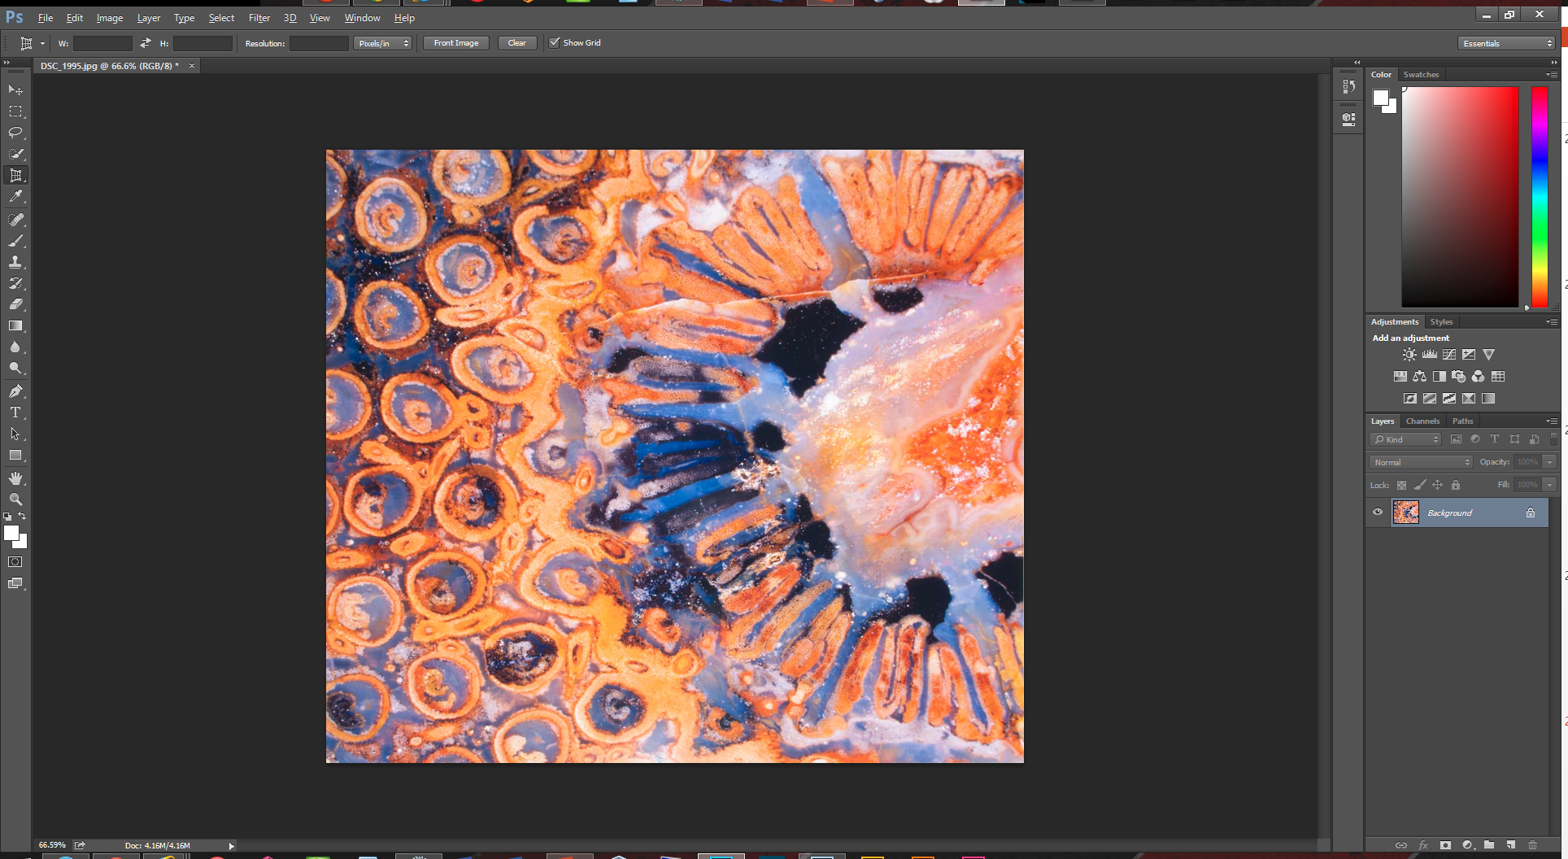

Slide 33
Sculptures
Use a seamless to get rid of distracting backgrounds

Slide 34
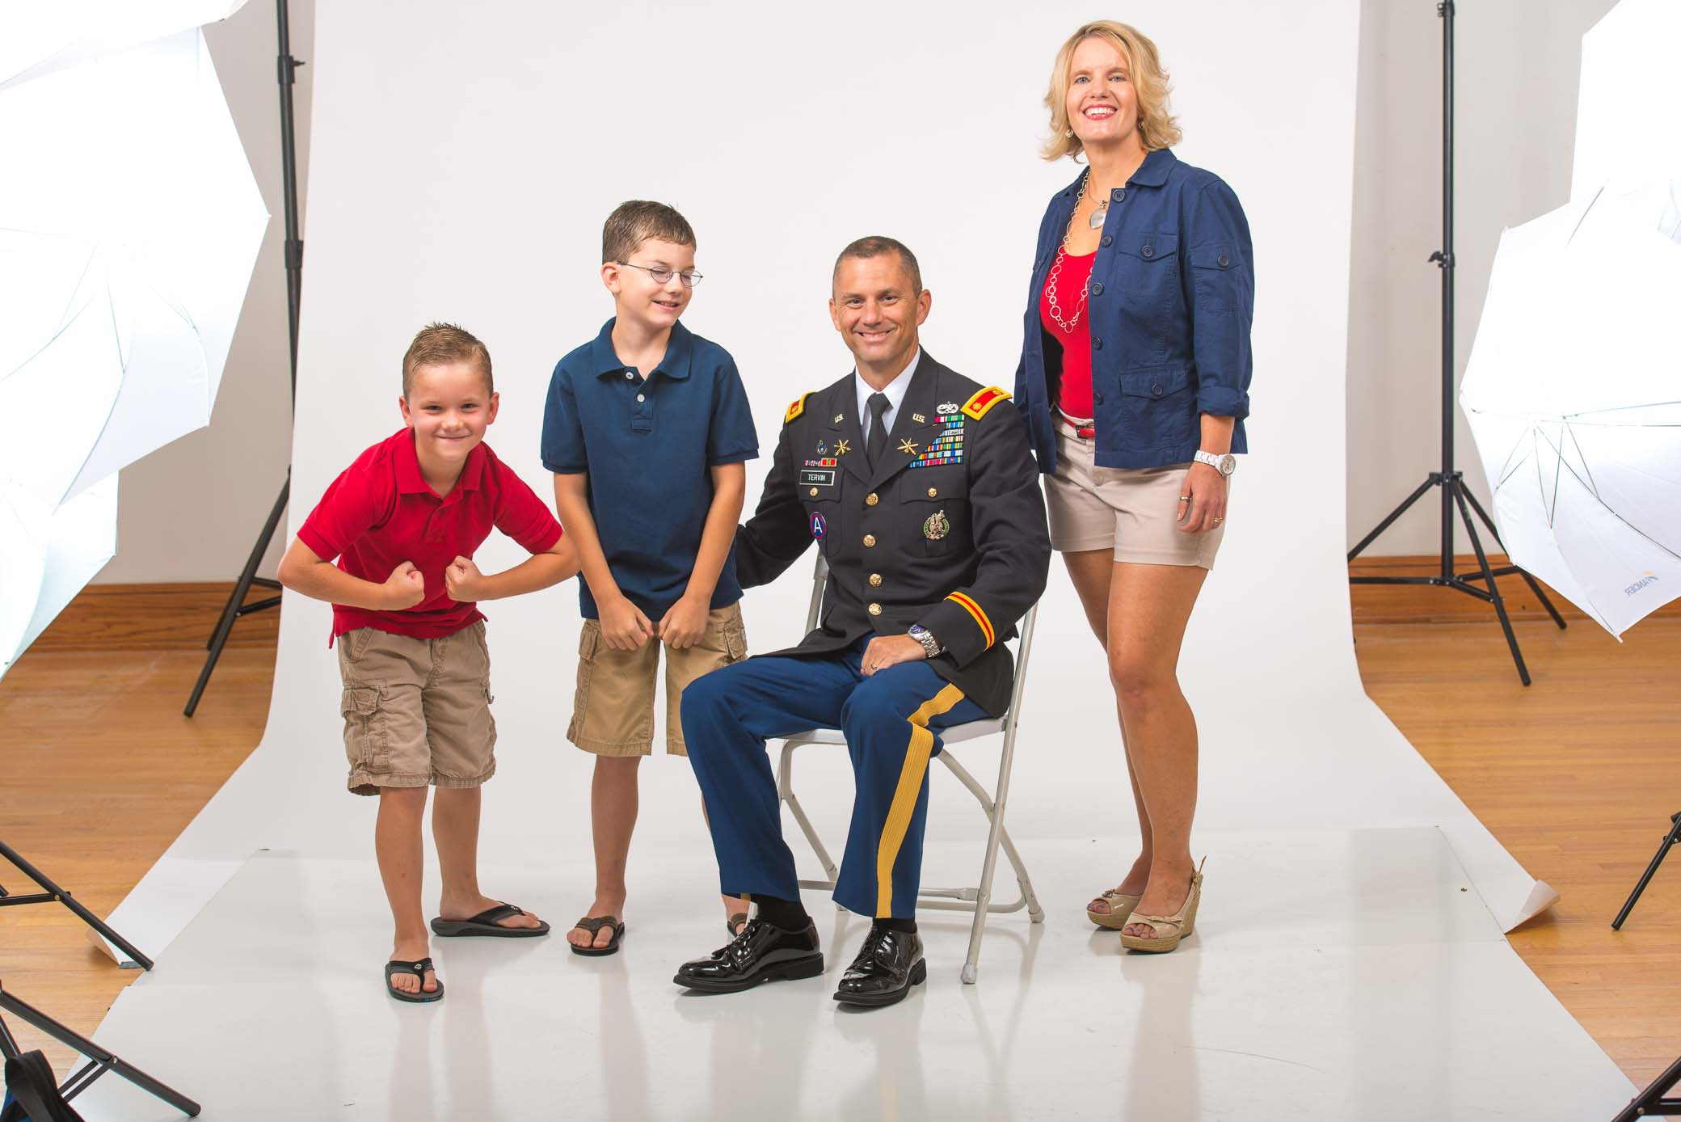
Sculptures
Large seamless can be used for portrait or big sculptures

Slide 35
Sculptures
Cloth Backdrops
Have to be ironed
Have to be lint rolled
Last longer than paper
More durable than paper
Paper Backdrops
No ironing required
More pristine when new
No wrinkles in photo

Slide 36
Sculptures
Overhead lighting & black backgrounds create drama

Slide 37
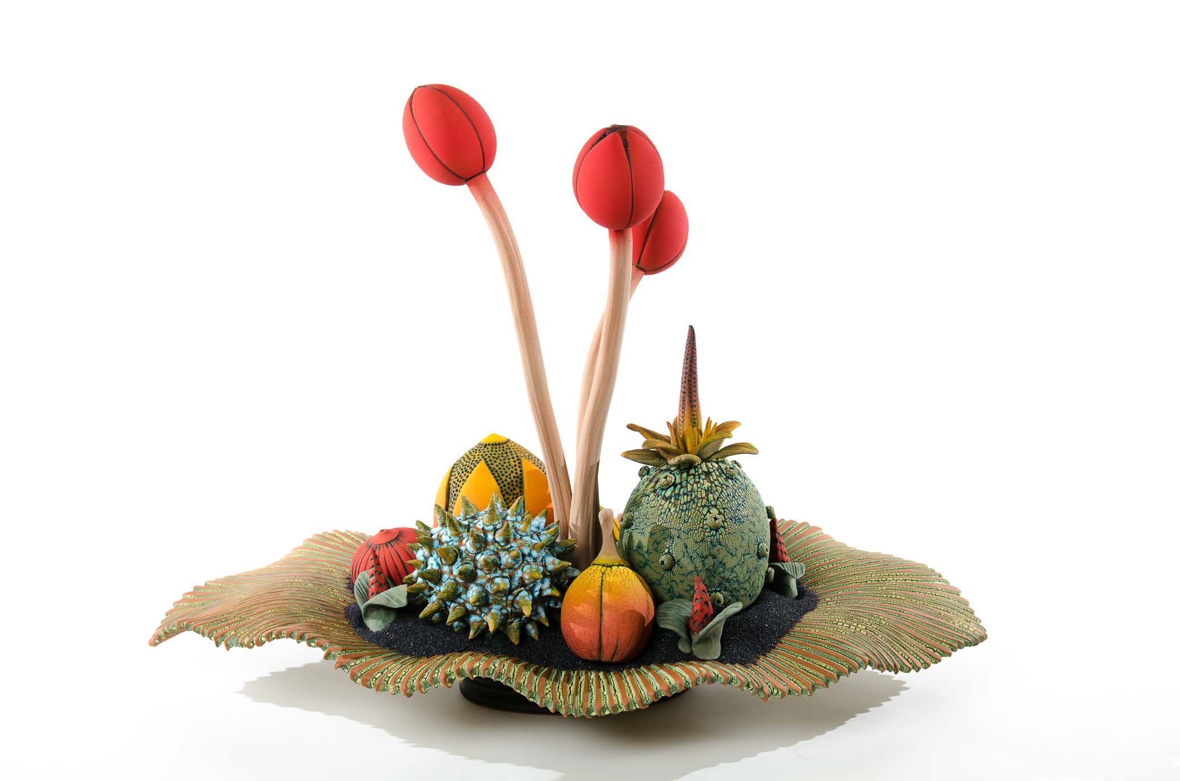
Sculptures
Side-lighting & white backgrounds make it easy to see the art

Slide 38
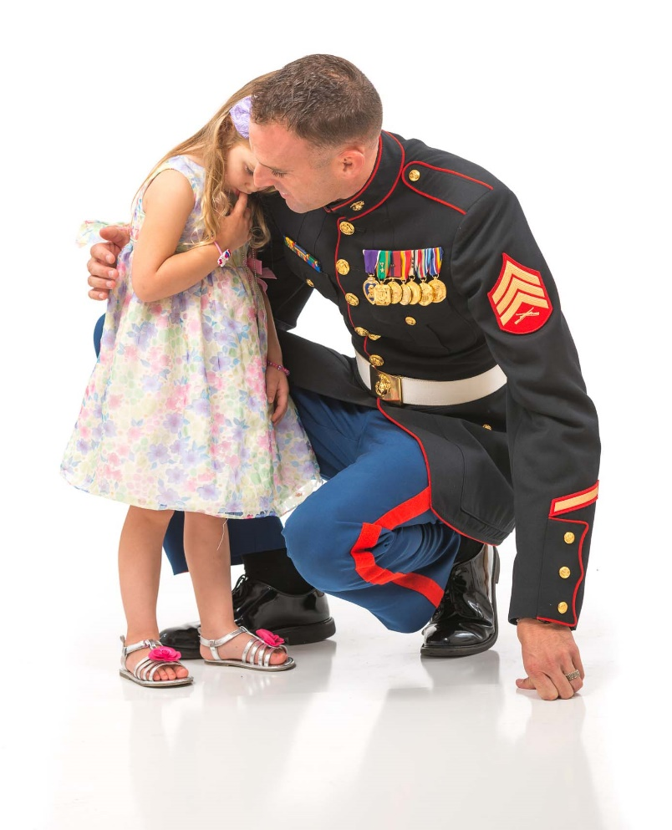
Sculptures
Lighting a white background makes it turn pure white

Slide 39
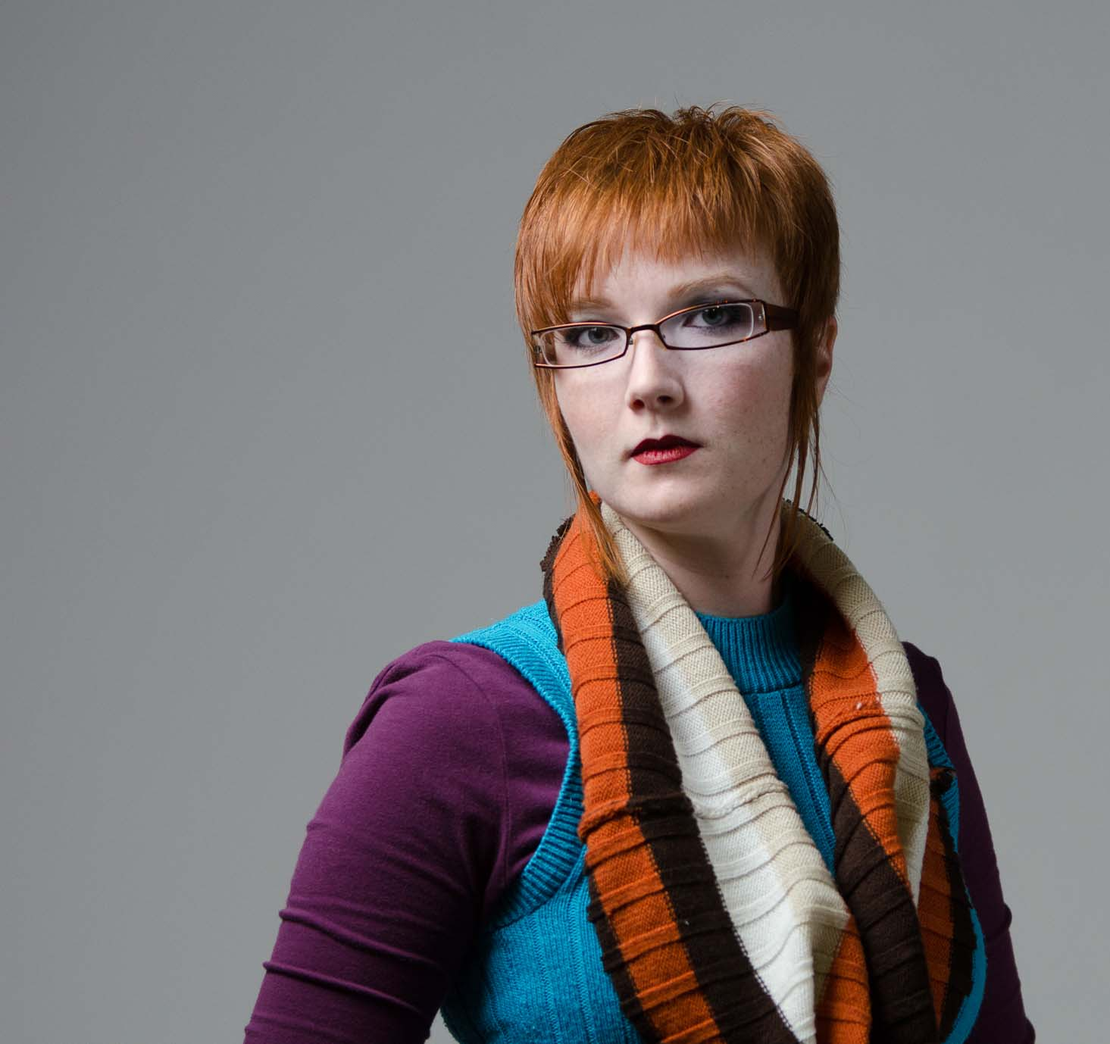
Sculptures
If you don’t light the background, white will turn gray

Slide 40
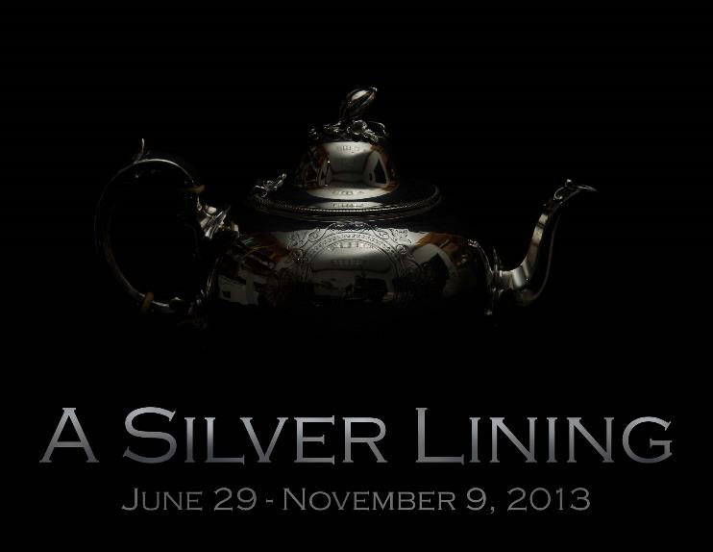
Crop & Cleanup Image

Slide 41
Final Step: Resize Photo for Output

Slide 42
Resizing Photos

Slide 43
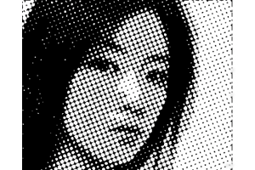
Pixel

Slide 44
Dimensions
1 Pixel

Slide 45
Dimensions
3 x 3
9 Pixels

Slide 46
Dimensions
6 x 6
36 Pixels

Slide 47
Dimensions
12 x 12
144 Pixels

Slide 48
Dimensions
36 x 36
1,296 Pixels

Slide 49
Dimensions
1,296 x 1,296
1,679,616 Pixels = (1.6 Megapixels)

Slide 50
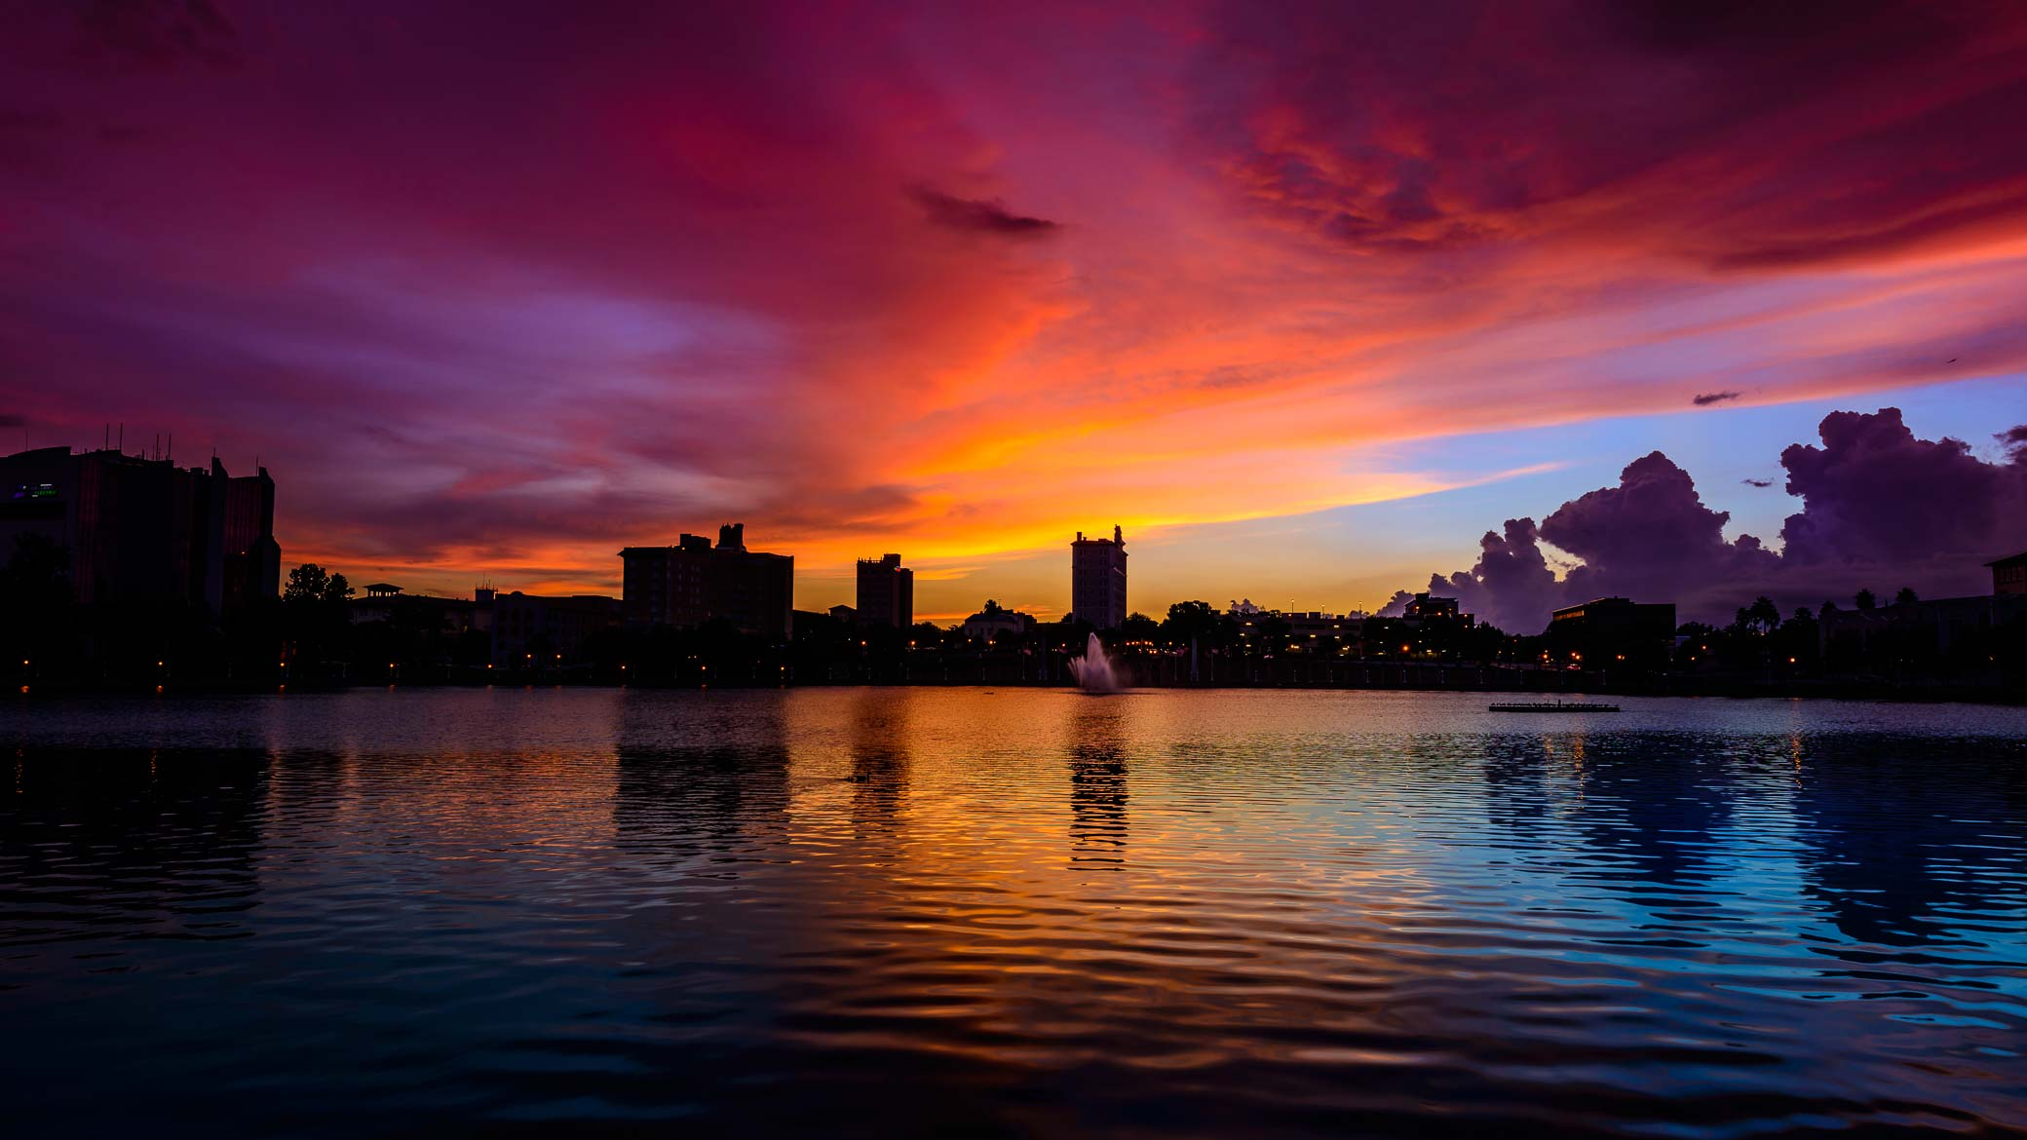
Dimensions
2080 pixels
1170 pixels
Short Edge
Long Edge

Slide 51
Dimensions
2080 pixels
693 pixels
Short Edge
Long Edge

Slide 52
Size (Megapixels)
Height X Width = Megapixels of a Camera
1,600 x 1,200 pixels = 1,920,000 pixels
2 MP Camera
3,000 x 2,000 pixels = 6,000,000 pixels
6 MP Camera
4,200 x 2,848 pixels = 11,961,600 pixels
12 MP Camera

Slide 53
1080 pixels long edge
Email or web

Slide 54
1920 pixels long edge
HD TV or PowerPoint

Slide 55
2080 pixels long edge
Facebook

Slide 56
Full Size
Printing or Production Printing

Slide 57
Camera Megapixels
Megapixels determine maximum print size not the quality of the photograph

Slide 58
Megapixels to Print Sizes
Maximum size your camera can print (approximately)
2 MP 1600 x 1200 4” x 6”
3 MP 2048 x 1536 5” x 7”
4 MP 2400 x 1600 6” x 8”
6 MP 3000 x 2000 7” x 10”
8 MP 3600 x 2400 10” x 14”
12 MP 4200 x 2800 16” x 24”
16 MP 4920 x 3264 20” x 30”
36 MP 7360 x 4912 30” x 45”

Slide 59
Resolution (DPI/PPI)
36 x 36 Pixels
36 x 36 Pixels
1” x 1” = 36 PPI
4” x 4” = 9 PPI

Slide 60
Resolution (DPI/PPI)
1,296 x 1,296
1,296 x 1,296
1” x 1” = 1,296 PPI
4” x 4” = 324 PPI

Slide 61
Resolution (DPI/PPI)
72 & 300

Slide 62
Resolution (DPI/PPI)
PPI – Pixels Per Inch (Monitors)
DPI – Dots Per Inch (Print)
Monitors – 96 or 72 PPI
Inkjet Printers - 300 or 240 DPI
Cameras - 300 or 72 PPI

Slide 63
Aspect Ratio
1:1
4:3
3:2
4:2
16:9

Slide 64
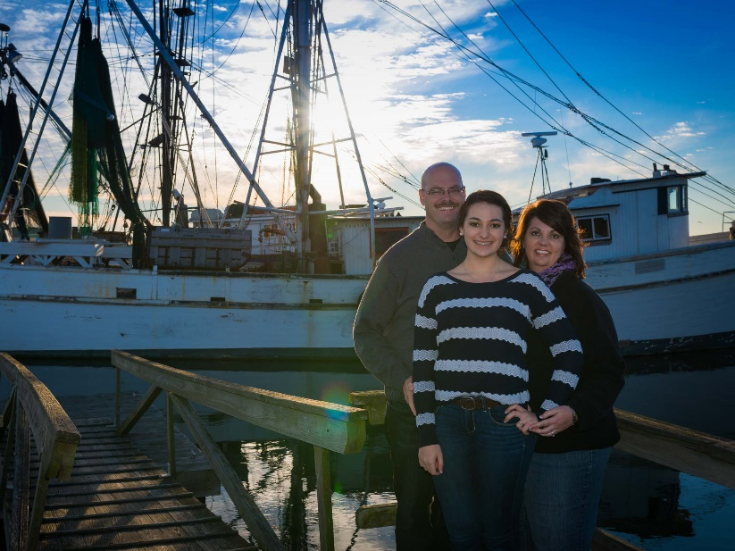
Aspect Ratio
4:3
16:9

Slide 65
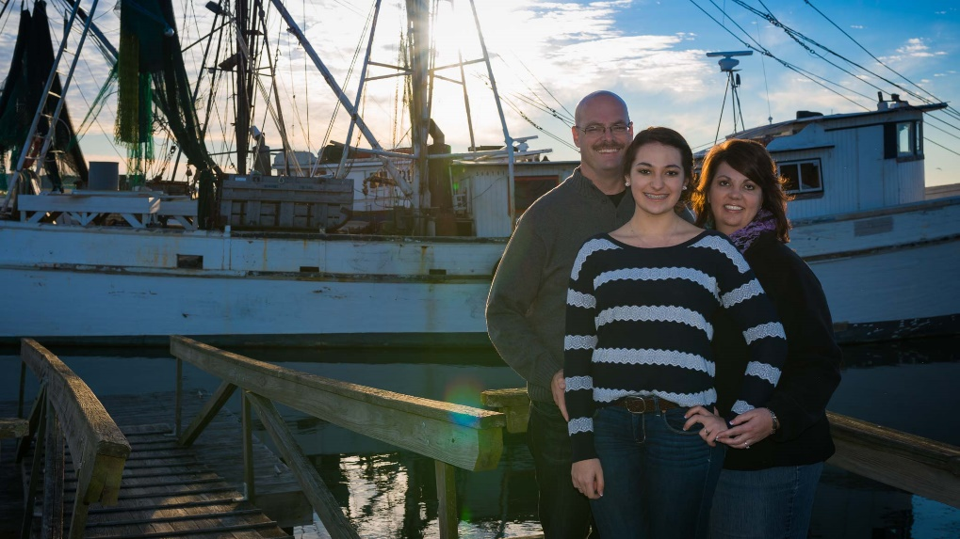
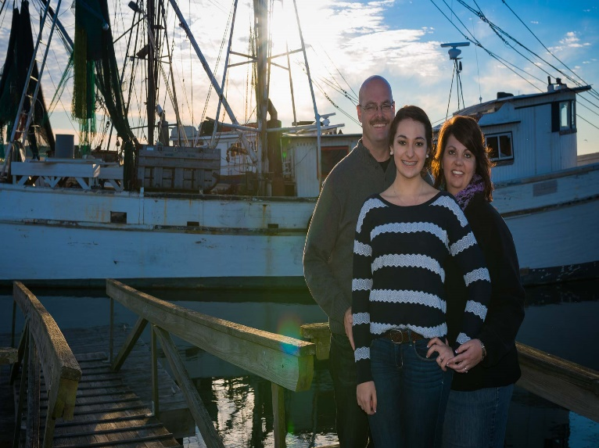
Aspect Ratio
16:9
4:3

Slide 66
Other Terms

Slide 67
File Formats
JPEG
Raw (not an abbreviation)
Tiff (Do not use)

Slide 68
Color Space
sRGB
AdobeRGB 1998
LAB
ProPhoto

Slide 69
RGB vs. CMYK
RGB
CMYK
CcMmYK

Slide 70
Understanding Entry Forms for Shows and Competitions

Slide 71
Zapp
Formatting Your Images Please follow these specifications in order to attach these images to your application successfully.
Recommended Dimensions: 1920 pixels on the longest side. Note: To assist artists who do not have images that are 1920 pixels or larger, the system will also accept images that are at least 1400 pixels on the longest side.
File Format: Save all images as Baseline Standard JPEG. Do not save as a Progressive JPEG.
File Size: JPEGs should be under 5 MB in size.
Resolution: 72 dpi Note: This resolution size will assist in lowering the file size
Color space: Save images in RGB color space, preferably sRGB.

Slide 72
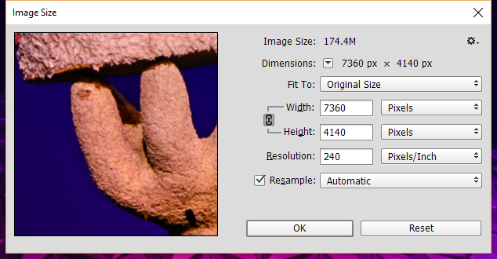
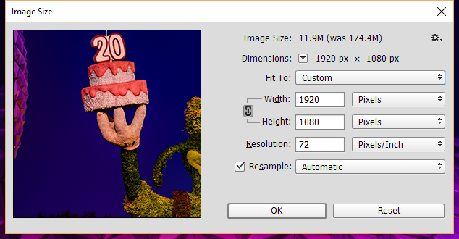
Photoshop

Slide 73
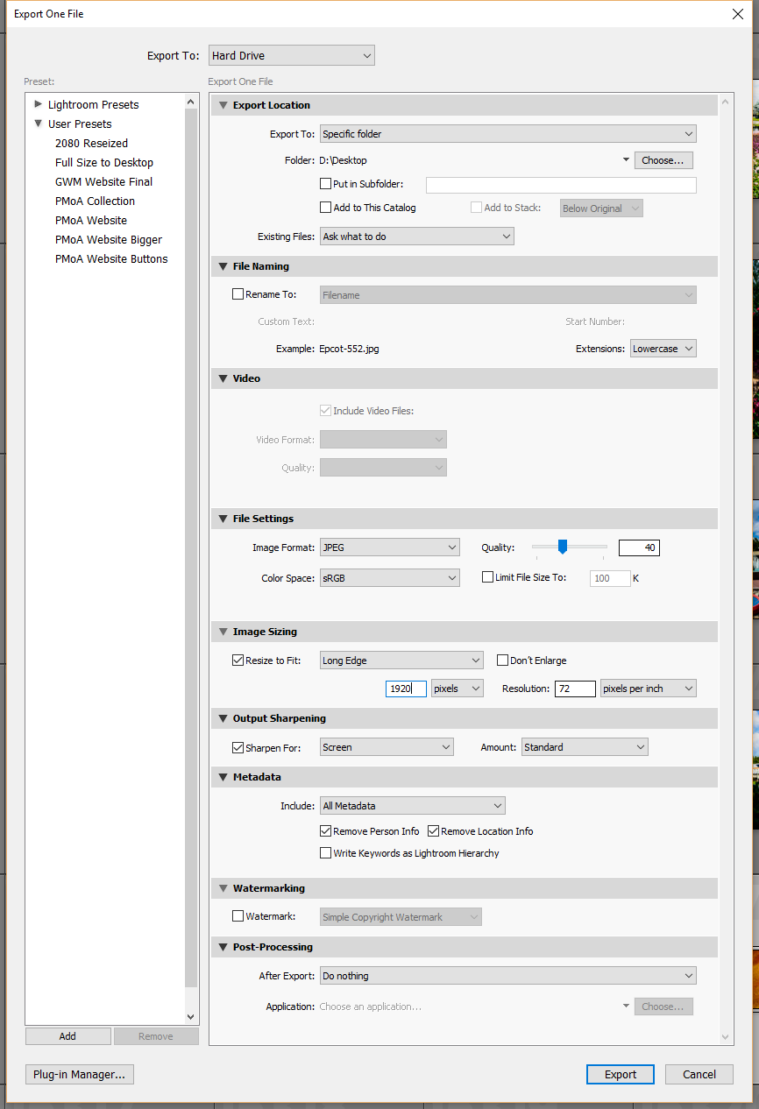
Lightroom

Slide 74
Lightroom

Slide 75
Questions?

Slide 76
Photography Classes

Slide 77
Beginning to Intermediate Photography
Polk Museum of Art
Feb 2 – Mar 8 (Tuesdays)
6:00pm – 9:00pm
$100 for Members, $120 for Non-Members
Intermediate to Advanced Photography
Polk Museum of Art
Feb 2 – Mar 8 (Tuesdays)
6:00pm – 9:00pm
$100 for Members, $120 for Non-Members

Slide 78
Using Adobe Lightroom
Polk Museum of Art
Mar 12 (Saturday)
10:00am – 4:00pm
$80 for Members, $100 for Non-Members
Using Adobe Photoshop
Polk Museum of Art
Mar 19 (Saturday)
10:00am – 4:00pm
$80 for Members, $100 for Non-Members

Slide 79
creativeLIVE.com
Lynda.com

Slide 80
GregoryMills.com
Sculptor | Photographer | Technologist
© 2016 by Gregory Mills

